Slide 2
Natural Language Processing for Text Classification and Beyond
Kristina Toutanova, Alexey Kamenev
Microsoft Research

Slide 3
Session Objectives and Takeaways
Session Objective(s)
Learn how text can be turned into feature vectors by explicit feature engineering
Learn how text can be turned into feature vectors using neural networks
Build confidence in training text classifiers using the computational network toolkit CNTK
Key Takeway 1
The right features are important: use these building blocks to build high-accuracy models for your problem
Key Takeway 2
Neural networks can automatically learn strong features from text
CNTK makes it easy for you to train and use powerful models for text

Slide 4
Agenda
From text documents to feature vectors
Word tokens and normalization
Stemming/lemmatization and base forms
Similar words
Beyond bag-of words
Let the model learn the feature vectors
From indicators to continuous representations
Convolutional neural networks for text
Recurrent neural networks for text
Training neural networks with CNTK
A brief glance at other text processing applications

Slide 5
Reminder: download and unzip code and data
\\kristout-1\MLADS234\
\\ct01\public\DNN\CNTK
\\B115FFDTES02\CNTK

Slide 6
From text documents to feature vectors

Slide 7
Sentiment Analysis
The gorgeously elaborate continuation of "The Lord of the Rings" trilogy is so huge that a column of words cannot adequately describe co-writer/director Peter Jackson's expanded vision of J . R . R . Tolkien's middle-earth.
Is this review positive or negative ?

Slide 8
Question Classification
Question: What is the highest waterfall in the United States?
What is the type of the expected answer to this question?
Description, Entity, Abbreviation, Human, Location, Numeric
Answer: Location

Slide 9
How can a model learn to classify text?
The gorgeously elaborate continuation of "The Lord of the Rings" trilogy is so huge that a column of words cannot adequately describe co-writer/director Peter Jackson's expanded vision of J . R . R . Tolkien's middle-earth.
What are the individual sentences and words in the text?
What are their basic forms and relationships?

Slide 10


MSR Splat Service and other Tools
MSR-SPLAT
An implementation of commonly used linguistic analysis tools
Tokenization, Stemming, Dependency Parsing, Semantic Roles …
Demo URL: http://msrsplatdemo.cloudapp.net/
Microsoft Internal Access: http://msrsplat/ (click Work tab for instructions)
Service URL:
RESTful Service Endpoint: http://msrsplat.cloudapp.net/SplatServiceJson.svc
WCF Service Endpoint: http://msrsplat.cloudapp.net/SplatService.svc
Key for MLADS participants: 088D9EF7-F032-4E34-AA1C-AB23AECA8B80
Contacts:
Chris Quirk: chrisq@microsoft.com
Lucy Vanderwende: lucyv@microsoft.com
Other Tools
Office NL toolkit http://officenltoolkit/
NLTK python library
…

Slide 11

Tokenization (getting words and sentences from the raw text)
The gorgeously elaborate continuation of “ The Lord of the Rings " trilogy is so huge that a column of words cannot adequately describe co-writer / director Peter Jackson 's expanded vision of J . R . R . Tolkien's middle-earth . <eos>
Relatively simple and can be done pretty accurately with regular expressions
Not perfect though, can always do a little bit better
Analyzer: Tokens

Slide 12
Bag-of-word text representation
What is the highest waterfall in the United States ?
Token | Value
What | 1
is | 1
the | 2
highest | 1
waterfall | 1
in | 1
United | 1
States | 1
? | 1
$$v_{1}$$

Slide 13
Bag-of-word text representation
What is the highest waterfall in the United States ?
what are high waterfalls in the united states
Token | Value
What | 1
is | 1
the | 2
highest | 1
waterfall | 1
in | 1
United | 1
States | 1
? | 1
Token | Value
what | 1
are | 1
high | 1
waterfalls | 1
in | 1
the | 1
united | 1
states | 1
$$v_{1}$$
$$v_{2}$$
$$Only two tokens are shared!$$

Slide 14
Case normalization and lemmatization
What is the highest waterfall in the United States ?
what are high waterfalls in the united states
Token | Value
what | 1
is | 1
the | 2
high | 1
waterfall | 1
in | 1
united | 1
states | 1
? | 1
Token | Value
what | 1
are | 1
high | 1
waterfall | 1
in | 1
the | 1
united | 1
states | 1
$$v_{1}$$
$$Seven tokens are shared!$$

Slide 15
Stemming/lemmatization/base forms
Word | elaborately
Lemma | elaborately
Base Form | elaborate
Stem | elabor
Word | elaborate
Lemma | elaborate
Base Form | elaborate
Stem | elabor
Different definitions of related forms of words (stemming, lemmatization, and derivational morphology)
Analyzers: Lemmas, Base Forms, Stemmer
NLTK

Slide 16
Stemming/lemmatization/base forms
Word | movement
Lemma | movement
Base Form | move
Stem | movement
Word | moving
Lemma | move
Base Form | move
Stem | move
Lemma is most conservative.
Base Form results in most normalization.

Slide 17
Beyond stemming and normalization: manually defined word classes
waterfall vs falls
WordNet (manually built lexical resource)
waterfall -> falls (falls is a synonym of waterfall)
Existing definitions of groups of words belonging to the same class:
Countries, cities, person names, …
Part-of-speech tags

Slide 18
Named entity and Part-of-speech normalization
What is the highest waterfall in the United States ?
What is the longest river in Canada ?
Token | Value
what | 1
is | 1
the | 1
AdjS | 1
waterfall | 1
in | 1
Country | 1
? | 1
Token | Value
what | 1
is | 1
the | 1
AdjS | 1
river | 1
in | 1
Country | 1
? | 1
Mapping some words to their part-of-speech or named entity type can help reveal patterns in the text.

Slide 19
Beyond stemming and normalization-automatically learned clusters
waterfall versus river
Automatically built word clusters, e.g. Brown Clusters.
Hierarchical hard clustering based on the context of word co-occurrence in a large text collection.
waterfall: cluster 011111001011100
river: cluster 011111001011000
words clustered into 8,192 clusters available at \\KRISTOUT-1\BrownClusters
Code developed by Veljko Miljanic, clusters trained by Hany Hassan
Clusters are the same up to a prefix of 11 bits!

Slide 20
Beyond stemming and normalization-automatically learned clusters
How to use:
Add features based on Brown Clusters at different granularities.
Two text vectors of words belonging to same clusters become more similar.
Reductions of error over state-of-the-art in NLP tasks using clusters
15% error reduction dependency parsing
23% error reduction NER

Slide 21
A word of caution for word normalization
When doing normalization we lose information that might matter.
Possible approach:
Experiment to find what works best for the specific problem.
Include several forms of tokens: original + normalized form.
Weigh different types of features differently (using different priors on weights).

Slide 22
Beyond bags of words - I
So far text was viewed as the bag of its tokens.
Representation very strong for text classification.
But we don’t express meaning using unordered bags of words.
The movie has character but no drama.
The movie has drama but no character.

Slide 23
Bag of bi-grams and higher order n-grams
The movie has character but no drama.
The movie has drama but no character.
Token | Value
<sos>_the | 1
the_movie | 1
movie_has | 1
has_character | 1
character_but | 1
but_no | 1
no_drama | 1
drama_<eos> | 1
Token | Value
<sos>_the | 1
the_movie | 1
movie_has | 1
has_darama | 1
drama_but | 1
but_no | 1
no_character | 1
character_<eos> | 1
Seven out of seven unigrams in common, four out of eight bigrams in common.

Slide 24
Beyond bag-of-words II
Question: What is the highest waterfall in the United States?
Unigrams or n-grams don’t capture that the question is asking about a waterfall
(need to skip “is the highest” to form “What … waterfall”)
Linguistic analyzers can provide the information more directly
cop(What-1, is-2)
det(waterfall-5, the-3)
amod(waterfall-5, highest-4)
nsubj(What-1, waterfall-5)
case(United_States-9, in-6)
nmod(waterfall-5, United_States-9)
Exchange Online$→$Migration
Analyzers: Labeled Dependency Tree, Semantic Roles
NLTK

Slide 25
How to define features using linguistic analyzers
Triples from direct relationships
Could also look at indirect relations (looking at dependency tree path between two words)
Token | Value
cop_what_is | 1
det_waterfall_the | 1
amod_waterfall_highest | 1
nsubj_what_waterfall | 1
case_united_states_in | 1
nmod_waterfall_united_states | 1
cop(What-1, is-2)
det(waterfall-5, the-3)
amod(waterfall-5, highest-4)
nsubj(What-1, waterfall-5)
case(United_States-9, in-6)
nmod(waterfall-5, United_States-9)

Slide 26
Issues to watch out for beyond bag-of-words
Problems
The size of the feature set grows quickly
N-grams introduce sparsity, noise
Problems for n-grams from linguistic analysis
Analysis might be wrong (state-of-the-art mid-80s F-measure)
Solutions
Hashing trick for memory (included in AzureML text analytics examples)
Different weight (prior) for n-gram features
Different weight (prior) of linguistic n-gram features
Making sure that features looking at simple unigrams are included as well
V V*V
10K 100mln

Slide 27
Some results on Question Classification
Experimental Settings
Dataset multiclass classification into 6 classes TREC “Question Classification” by Roth & Li
Generate features using different combinations of feature extractors
Train multi-class logistic regression with L2 penalty (selected on validation set)
Report test accuracy
Unigram models
Features | Accuracy
Bag-of-words (BOW) | 87.0
Lower-case (LC) | 85.8
Lemmatize (Lem) | 85.2
Porter-stem (Stm) | 84.8
Base-forms (Base) | 86.2
BOW+Base | 87.0
Features | Accuracy
BOW+Base+POS | 87.4
BOW+Base+POS+NE+BC | 89.0

Slide 28
Some results on Question Classification
Bigram models
Best unigram model: 89.0
Using only token normalization and contiguous n-grams
Also using n-grams from linguistic relationships (syntactic parsing)
Features | Accuracy
Bag-of-ngrams (BOW2) | 90.4
BOW2 & Base2 & POS2 | 91.0
BOW2 & Base2 & POS2 & NE2 &BC2 | 92.2
Features | Accuracy
BOW2 & Base2 & POS2 & NE2 &BC2 & DependencyLinks | 92.6*
*Caveat: small dataset, not statistically significant

Slide 29
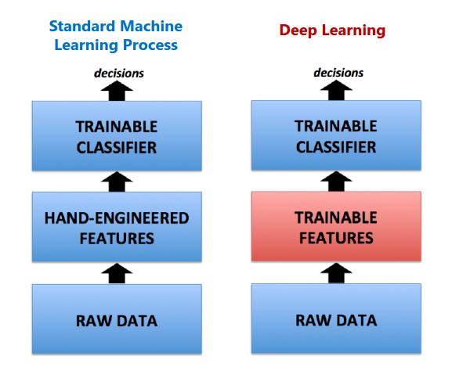
Let the model learn the feature vectors
Figure from Duh 14, adapted from Yih, He, Gao 15

Slide 30
Feature vectors for original words
Represent text as a fixed dimensionality vector, using sum of sparse vectors for each word, vector dimensionality is vocabulary size:
highest
waterfall
“highest waterfall”
“longest river”
longest
river
0
…
1
0
…
0
0
1
…
0
0
…
0
0
1
…
1
0
…
0
0
0
…
0
1
…
1
0
0
…
0
1
…
0
0
0
…
0
0
…
1
0
20,000
20,000
The similarity of highest waterfall and longest river is 0.
Logistic regression learns V*K parameters, e.g, 20,000 * 6 for a vocab size of 20,000 and 6 classes.

Slide 31
Feature vectors from clustered words
Each word is again a sparse vector (has 1 in a single position), but the dimensionality of the vector is lower.
The Brown Clusters of “waterfall” and “river” are the same (if we use 2048 clusters) .
But words are alike in some ways and differ in other ways, how to capture this?
How to make sure the clusters we are learning are relevant to the classification task?
waterfall
river
0
…
1
0
…
0
0
0
…
1
0
…
0
0
cluster 345
cluster 345
2,048
2,048

Slide 32
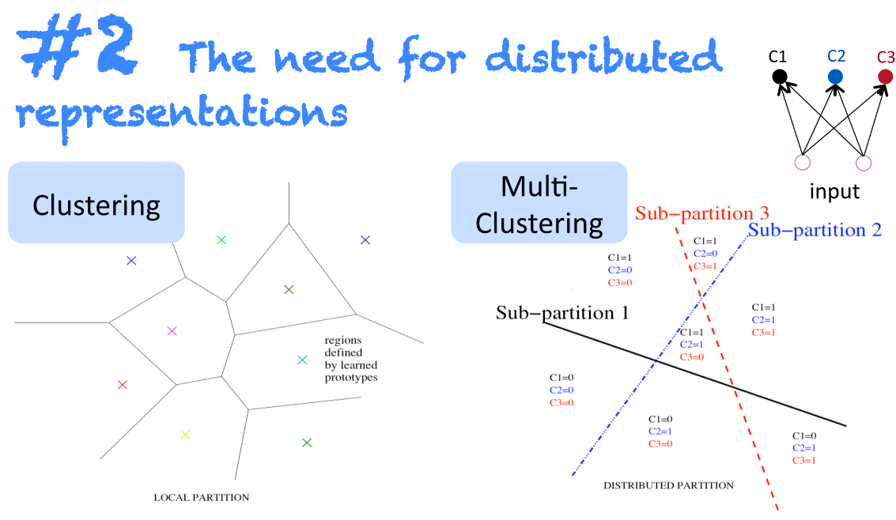
The need for distributed representations
Distributed representations versus word clusters. Slide from Socher & Manning NAACL 2013 tutorial.

Slide 33
Neural word embeddings as a distributed representation
waterfall
river
-0.12
1.71
-1.97
-0.58
1.04
-0.49
0.02
….
0.21
1.64
-0.19
0.09
1.61
0.45
-0.12 …
Excerpt from actual 50-dimensional word embeddings from Turian et al 2010.

Slide 34
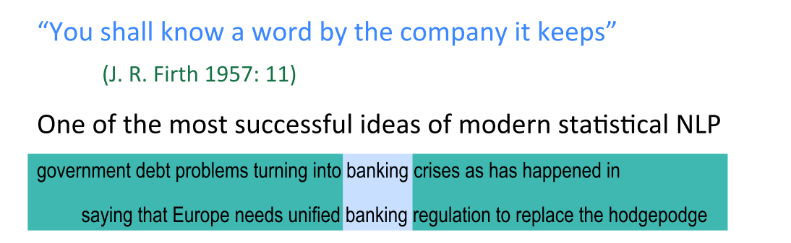
Unsupervised learning of neural word representations
Learn the embedding of each word on a large amount of unlabeled text.
The main idea is that the learned word embeddings should be predictive of the words in the context of occurrence of each word (idea also used for Brown clustering)
Slide from Socher & Manning NAACL 2013 tutorial.

Slide 35
Where are the embeddings
Can download pre-trained vectors trained on large datasets
Glove embeddings: http://nlp.stanford.edu/projects/glove/
Word2Vec embeddings (330 dim trained on Google news): GoogleNews-vectors-negative300.bin.gz
Various resources within and outside of Microsoft
https://microsoft.sharepoint.com/teams/wordembeddingresearch
MSR continuous space text representations http://msrcstr/Default.aspx

Slide 36
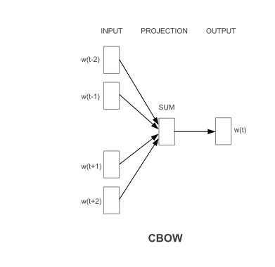
How are the word embeddings learned on unlabeled text
Example: Word2Vec (Continuous Bag-of-Words)
Learn two embedding vectors $v_{w}^{in}$ and $v_{w}^{out}$ for each word.
For every sentence in a large document collection, the neighbors of each word should predict the word well.

Slide 37
How are the word embeddings learned on unlabeled text
Example: Word2Vec (Continuous Bag-of-Words)
Few things in nature are as mesmerizing as a waterfall – the thunderous roar as water ..
$v_{mesmerizing}^{in}+v_{as}^{in}+v_{a}^{in}$+$v_{−−}^{in}{+v}_{the}^{in}+v_{thunderous}^{in}+v_{roar}^{in}$
similar to
$$v_{waterfall }^{out}$$
2*V*d parameters to learn
Large but can use huge unlabeled dataset

Slide 38
How to use word embeddings for classification – simple bag-of-embeddings
Given a set of vectors for the words in a text segment, we can average or add them up to obtain a vector for the full text.
Apply logistic regression, SVM, or multi-layer neural network to resulting 300-dim dense vectors.
May perform well depending on problem but we can usually do better
How about word order?
highest
waterfall
“highest waterfall”
--1.9
0.3
1.5
…
0.1
-0.01
0.2
…
--1.8
0.29
1.7
…
300

Slide 39
Using word embeddings to capture meaning in word sequences: convolution and recurrence
With bag of words representations, introduced word n-grams to capture the meaning of word combinations
V words, V*V bigrams ; classifier learns V*V*K weights – very sparse!
Convolutional neural networks and RNN over sequences can model non-linear interactions among words.
Using a small number of parameters

Slide 40
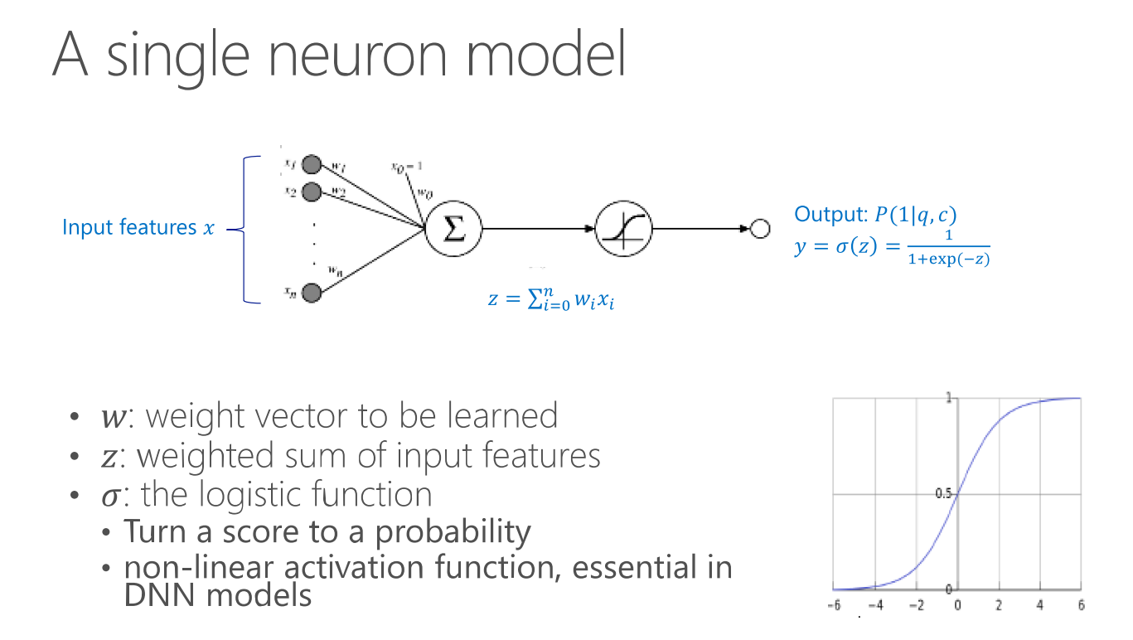
Brief background: neural networks
$$P(1|x)$$
Figure from Yih, He, Gao tutorial at NAACL 2015.
Same as 2-class logistic regression

Slide 41
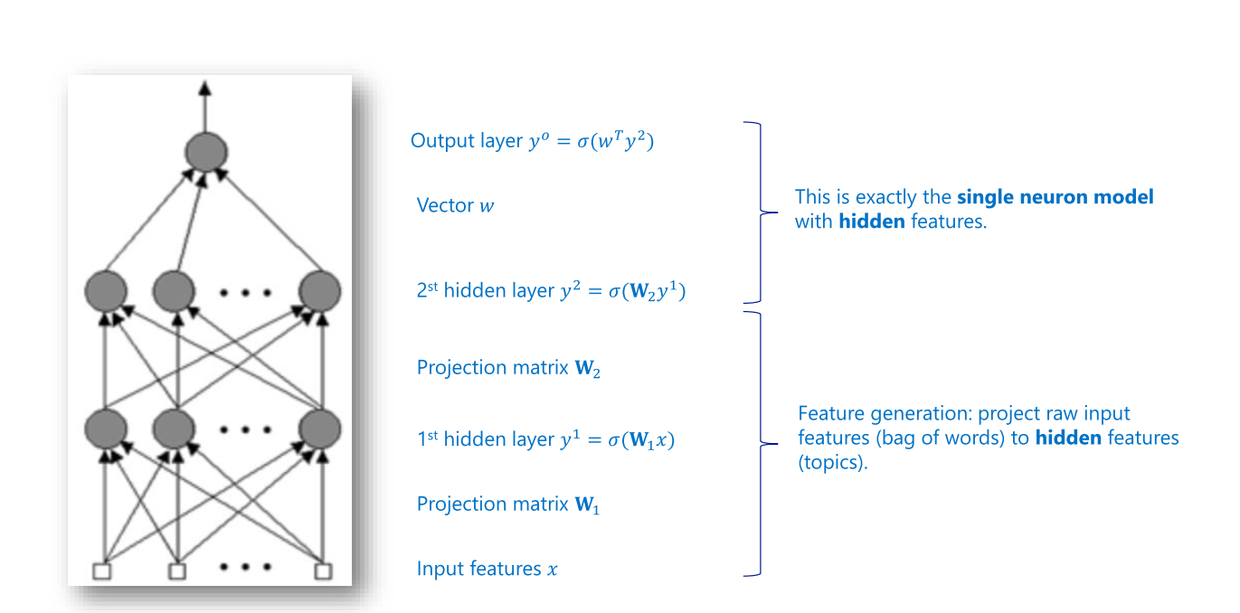
Multi-layer neural network
Figure from Yih, He, Gao tutorial at NAACL 2015.

Slide 42

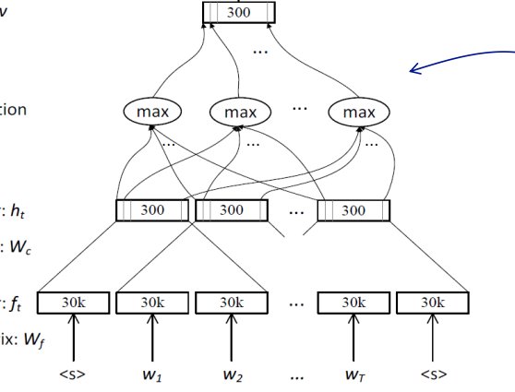

General convolution overview
Logistic Regression
Filter (w,b) produces feature at each position
Filter applied at each 3-word window produces an array of feature values (feature map)
Max-pooling operation produces a single value for the whole sequence (sentence)
400
400
400
400
400
Finally we turned the variable-length sentence into a 300-dimensional feature vector.
Figure from Yih, He, Gao tutorial at NAACL 2015.

Slide 43
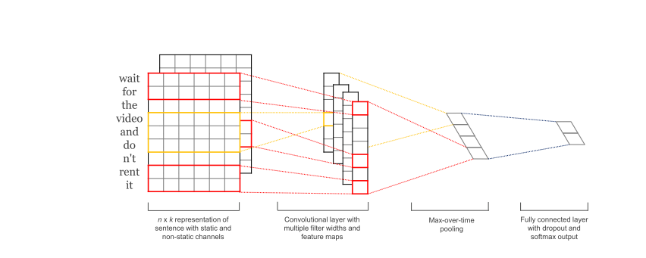
Model from Kim [EMNLP 2014]
Multiple windows of convolution: 3,4,5
100 filters for each window
Two sets of word embeddings for each word:
one fixed to word2vec CBOW
another initialized with CBOW but updated during training to tune to task

Slide 44
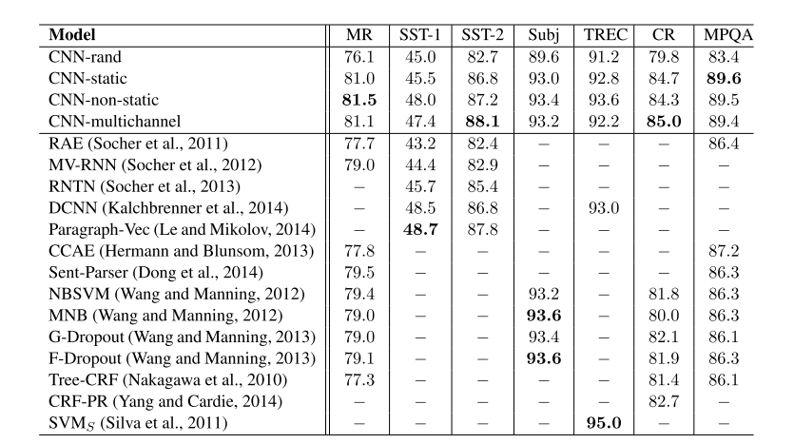
Results on sentence classification from Kim 2014

Slide 45


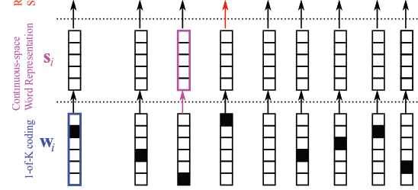
Recurrent neural networks for representing text
Logistic Regression
Hidden state at position i represents all relevant information from the beginning of the sentence to this position
Final hidden state is the feature vector for the sentence
<s> What is a waterfall in the United States
Figure adapted from Cho et. Al 2015

Slide 46

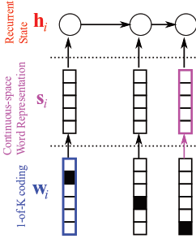
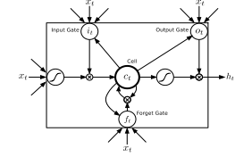
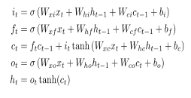
Computing hidden vectors
Basic RNN hidden state computation
$z_{t}=Us_{t}+Wh_{t−1}$
$h_{t}=σ(z_{t})$ $σ$ – logistic or other non-linearity
We hope hidden state will capture all relevant information
In practice, vanishing/exploding gradient problems
Solution
Model explicit “memory” dynamic to encourage persistence of information
A long-short-term memory cell (LSTM)

Slide 47
Agenda
From text documents to feature vectors
Word tokens and normalization
Stemming/lemmatization and base forms
Similar words
Beyond bag-of words
Let the model learn the feature vectors
From indicators to continuous representations
Convolutional neural networks for text
Recurrent neural networks for text
Training neural networks with CNTK
A brief glance at other text processing applications

Slide 48
Training neural networks
A brief introduction to CNTK
A hands-on experiment on Question Classification using CNTK

Slide 49
CNTK: deep learning framework
Alexey Kamenev

Slide 50
CNTK Overview
CNTK: Computational Network ToolKit
Created by MSR Speech researchers several years ago
Unified framework for building:
Deep Neural Networks (DNNs)
Recurrent Neural Networks (RNNs)
Long Short Term Memory networks (LSTMs)
Convolutional Neural Networks (CNNs)
Deep Structured Semantic Models (DSSMs)
and few other things…
All types of deep learning applications: speech, vision and text

Slide 51
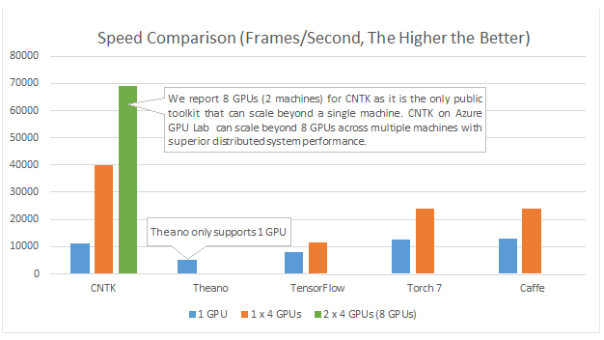
CNTK vs …
CNTK

Slide 52
Configuring CNTK
Define computation graph
Feed forward, recurrent and convolutional nets
Define training parameters:
Command definitions
Learner (SGD) parameters
Adaptive learning algorithms supported (AdaGrad, RmsProp, FSAdaGrad)
Data reader settings
Optional: define model transformations

Slide 53
NDL example
Simple, one-hidden layer network (MNIST)
Main file:
Macros file:
# input dimension
FeatDim = 784
# label dimension
LabelDim = 10
features = Input(FeatDim, tag = feature)
featScale = Const(0.00390625)
featScaled = Scale(featScale, features)
labels = Input(LabelDim, tag = label)
HiddenDim = 200
h1=DNNLayer(FeatDim, HiddenDim, featScaled, 1)
ol=DNNLastLayer(labelDim, HiddenDim, h1, 1)
CE = CrossEntropyWithSoftmax(labels, ol, tag = Criteria)
Err = ErrorPrediction(labels, ol, tag = Eval)
OutputNodes = ol
DNNLayer(inDim, outDim, x, parmScale)
{
W = Parameter(outDim, inDim, init = Uniform,
initValueScale = parmScale)
b = Parameter(outDim, init = Uniform,
initValueScale = parmScale)
t = Times(W, x)
z = Plus(t, b)
y = sigmoid(z)
}
DNNLastLayer(LabelDim, hiddenDim, x, parmScale)
{
W = Parameter(LabelDim, hiddenDim, init = Uniform,
initValueScale = parmScale)
b = Parameter(LabelDim, init = Uniform,
initValueScale = parmScale)
t = Times(W, x)
z = Plus(t, b)
}

Slide 54
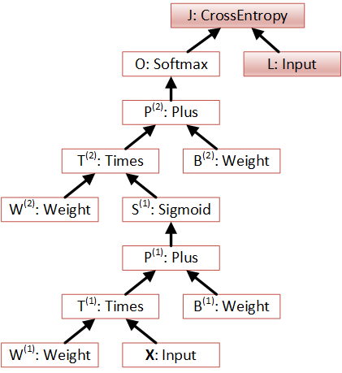
NDL example (cont.)
Data flows through the graph, computations performed in the nodes
Automatic differentiation is enabled by recursive gradient computation algorithm

Slide 55
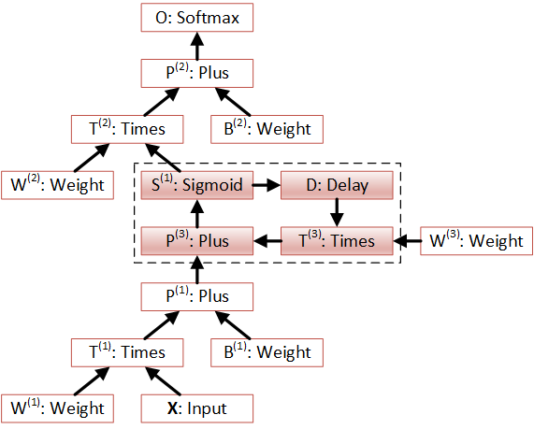
NDL example: LSTM
LSTMPComponent(inputDim, outputDim, cellDim, inputx)
{
Wxo = Parameter(cellDim, inputDim, init=uniform, initValueScale=1);
Wxi = Parameter(cellDim, inputDim, init=uniform, initValueScale=1);
Wxf = Parameter(cellDim, inputDim, init=uniform, initValueScale=1);
Wxc = Parameter(cellDim, inputDim, init=uniform, initValueScale=1);
...
dh = PastValue(outputDim, output, timeStep=1);
dc = PastValue(cellDim, ct, timeStep=1);
Wxix = Times(Wxi, Scale(expsWxi, inputx));
Whidh = Times(Whi, Scale(expsWhi, dh));
Wcidc = DiagTimes(Wci, Scale(expsWci, dc));
it = Sigmoid (Plus ( Plus (Plus (Wxix, bi), Whidh), Wcidc));
...
Wxox = Times(Wxo, Scale(expsWxo, inputx));
Whodh = Times(Who, Scale(expsWho, dh));
Wcoct = DiagTimes(Wco, Scale(expsWco, ct));
ot = Sigmoid( Plus( Plus( Plus(Wxox, bo), Whodh), Wcoct));
mt = ElementTimes(ot, Tanh(ct));
output = Times(Wmr, Scale(expsWmr, mt));
}
LSTM layer of arbitrary complexity can be defined in NDL
PastValue node is the key
No need to write from scratch – plenty of examples are available

Slide 56
CNTK in production: Project Philly
Turnkey GPU DNN training cluster
Scalable to hundreds of NVIDIA GPUs
Rapid, no-hassle, DNN experimentation
Larger models and training data sets
Multitenant
Fault tolerant
Open source friendly
3rd party accessible

Slide 57
How we use Project Philly
Massive improvement in training time with greater scale
Enable bigger data and more complicated algorithms
Used company-wide for DNN training
Available for experimental and production jobs
Future plan to make it a public service
Partnership with Azure

Slide 58
Why Linux and OSS?
Standard in deep learning community
OSS infrastructure components
Allows for rapid build out a turnkey, capable system with fault tolerance
Industry recognized innovative, state of the art cloud tools
Components easily compose into solid platform
GPUDirect RDMA and CUDA aware MPI are currently available on Linux only
Key to low latency networking and scale out

Slide 59

Job submit job monitor
Node0 GPU0,1,2,3
Node1 GPU0,1,2,3
Node2 GPU1
Node2 GPU2
…
Web
Portal
CNTK
CNTK
CNTK
CNTK
Data Ingress / Egress
JobA User0
JobA User0
JobB User1
JobC User2
REST API
Docker (Ubuntu Distribution)
Samba
YARN (Job/Container Scheduling, Resource Management)
FUSE
HDFS (Distributed Storage)
CoreOS

Slide 60
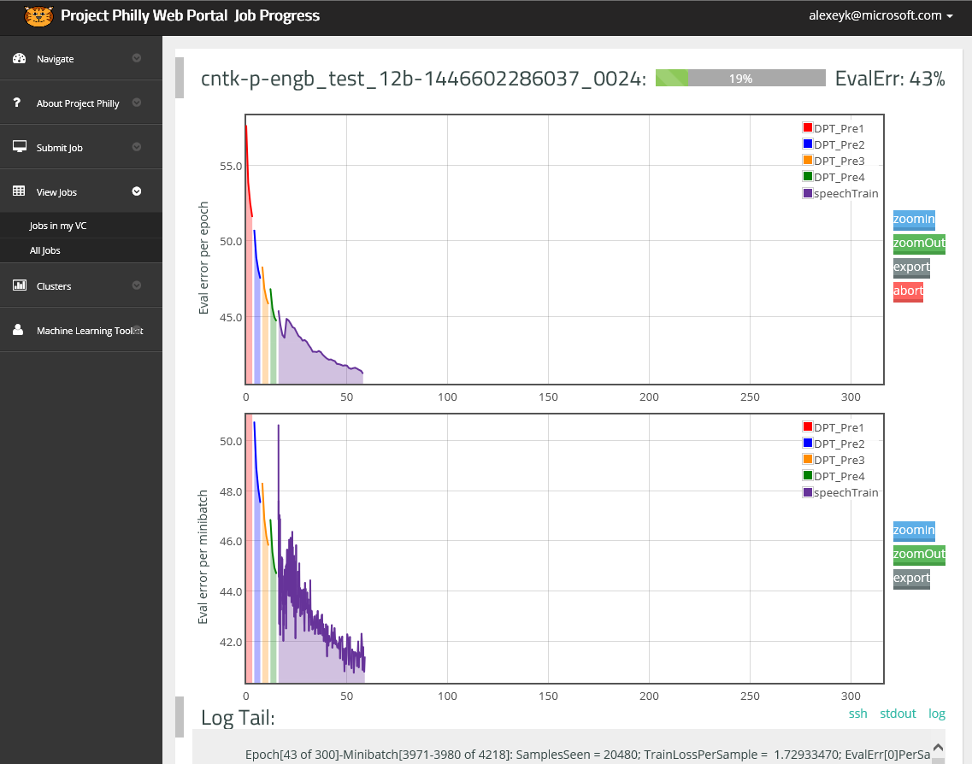
https://philly/

Slide 61
An experiment on question classification with CNTK
Prerequisites:
CNTK_Release
QueryTask
\\kristout-1\MLADS234\
\\ct01\public\DNN\CNTK
\\B115FFDTES02\CNTK

Slide 62
CNTK configuration files
Defines sequence of commands:
command=LSTM:LSTMTest
LSTM=[
action=train
traceLevel=1
# output model path
modelPath=$ExpDir$\cntkdebug.dnn
NDLNetworkBuilder=[
networkDescription=$NdlDir$\lstm.txt
]
SGD=[
maxEpochs=100 #maximum number of training epochs
epochSize=71524 #maximum number of words per epoch
learningRatesPerSample=0.1 #the initial learning rate
momentumAsTimeConstant=1000 #momentum
…
]
..]

Slide 63
NDL example: LSTM for Query Classification
ndlCreateNetwork=[
inputDim=3414
featDim=3414 # should be inputDim * lookupTableOrder
lookupDim=300 #word embedding size
lookupedDim=300 #should be lookupDim * 1 since we use lookupTableOrder of 1
labelDim=7
hiddenDim=600 #dimension of the hidden layer feature vectors
initScale=6
initBias=-1.0
features=Input(featDim, tag=feature)
labels=Input(labelDim, tag=label)
# define network
Wlookup = Parameter(lookupDim, inputDim, init=Uniform, initValueScale=initScale);
featLookuped = LookupTable(Wlookup, features, init=Uniform, initValueScale=initScale);
#LSTM Layer 1
LSTMoutput = LSTMComponent(lookupedDim, hiddenDim, featLookuped, hiddenDimX2, hiddenDimX3, hiddenDimX4, initScale, i
nitBias);
W = Parameter(labelDim, hiddenDim, init=Uniform, initValueScale=initScale);
b = Parameter(labelDim, init=fixedvalue, value=0);
outputs = Plus(Times(W, LSTMoutput), b);
cr = CrossEntropyWithSoftmax(labels, outputs);

Slide 64
CNTK configuration files
And data reader(s): (for train, validation, and test sets in config file)
reader=[
# reader to use
readerType=LUSequenceReader
#the tokens at each position which form the embedded layer s (could be 0:1:2) for a three-token context window
wordContext=0
unk="<unk>"
wordmap=$DataDir$\inputmap.txt
file=$DataDir$\train.inputfeat.txt
labelIn=[
usewordmap=true
labelType=Category
beginSequence="BOS"
endSequence="EOS"
usewordmap=true
# input word list
token=$DataDir$\input.txt
]
labels=[
labelType=Category
# output token list
token=$DataDir$\output.txt
]

Slide 65
Testing model
command=LSTMTest
LSTMTest=[
action=write
traceLevel=1
modelPath=$ExpDir$\cntkdebug.dnn
outputNodeNames=outputs:labels
reader=[
# reader to use
readerType=LUSequenceReader
#the tokens at each position which form the embedded layer s (could be 0:1:2) for a three-token context window
wordContext=0
unk="<unk>"
wordmap=$DataDir$\inputmap.txt
file=$DataDir$\test.inputfeat.txt
…
]
]

Slide 66
Steps to train/test model
>D:\Users\kristout\QueryTask
>D:\users\kristout\CNTK_Release\CNTK.exe configFile=globalssmall.config+lstmsmall.config
If running on GPU, run testing separately due to GPU testing bug (to be fixed soon!)
>D:\users\kristout\CNTK_Release\CNTK.exe configFile=globalssmall.config+testlstmsmall.config
Get the accuracy of the model
>D:\Users\kristout\QueryTask> D:\Users\kristout\CNTK_Release\scorer.exe .\Experiment1\Small\output\output.rec.txt .\Experiment1\Small\output\output.lbl.txt
correct 332 out of 500
Accuracy 0.664
For full dataset, use globals.config lstm.config and testlstm.config
…
correct 453 out of 500
Accuracy 0.906

Slide 67
How to improve the models
Parameters to explore
lookupDim=300 #embedding size
hiddenDim=600 #hidden state size
Number of LSTM layers (uncomment relevant portion in lstm.txt)
learningRatesPerSample=0.1
momentumAsTimeConstant=1000
wordContext=0
Caveat: current version of text classification in CNTK adapted from sequence classification (predicting output at each position)
Expect an improved version and classification sample soon
Capabilities coming soon
Convolutional networks for text
Flexible readers to enable combination of manual feature design+automatic feature learning
Convenient methods for using pre-trained word embeddings (using large unlabeled text)

Slide 68
Other Resources on Neural Networks
Tutorials
Deep Learning and Continuous Representations for NLP (Tutorial for NAACL-HLT-2015)
Wen-tau Yih, Xiaodong He, and Jianfeng Gao
Deep learning for NLP
Richard Socher and Christopher Manning
An introduction to Computational Networks and the Computational Network Toolkit
Dong Yu et al. http://research.microsoft.com/apps/pubs/?id=226641
Courses
Stanford CS224d: Deep Learning for Natural Language Processing http://cs224d.stanford.edu/

Slide 69
A Brief Glance at Other NLP Applications

Slide 70
So Far: Text Classification
Input: Text
Text
Example: “What is the highest waterfall in the United States?”
A single categorical value
Output: One of a (usually small) set of classes
Example: Location
Description, Entity, Abbreviation, Human, Location, Numeric

Slide 71
Entity and Relation Extraction
Company report: “International Business Machines Corporation (IBM or the company) was incorporated in the State of New York on June 16, 1911, as the Computing-Tabulating-Recording Co. (C-T-R)…”
Extracted Complex Relation:
Company-Founding
Company IBM
Location New York
Date June 16, 1911
Original-Name Computing-Tabulating-Recording Co.
Text
A group of spans defining entities and a relation
A categorical label for the relation
Categorical role labels for the spans
(Possibly) Unique identifiers for disambiguated entities
Example from Jurafsky & Manning
Language Understanding Intelligent Service (LUIS)

Slide 72
Relation extraction without labeled sentences
city_of
Chicago
Honolulu
lived_in
Barack Obama worked in Chicago.
A photo of Barack Obama’s Chicago house.
born_in
United States
Barack Obama
spouse
Michelle Obama
Use knowledge base and text continuous representations to infer missing relationships between entities.
Figure from Toutanova et al. 2015 “Representing text for joint Embedding of Text and Knowledge Bases”

Slide 73
Question-answering (from a knowledge base)
Answers: Databases of Relations
born-in(“Emma Goldman”, “June 27 1869”)
author-of(“Cao Xue Qin”, “Dream of the Red Chamber”)
Draw from Wikipedia infoboxes, DBpedia, FreeBase, etc.
Questions: Extracting Relations in Questions
Whose granddaughter starred in E.T.?
(acted-in ?x “E.T.”)
(granddaughter-of ?x ?y)
Text
A formal query in a database query language
Example from Jurafsky & Manning

Slide 74
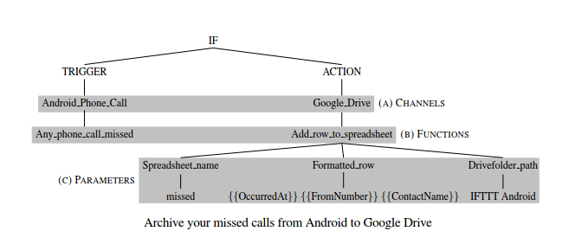
Language-to-code
Text
Executable code
Figure from Quirk et al 2015 “Language-to-code: Learning Semantic Parsers for IF-Then-That Recipes”

Slide 75

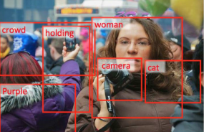

Text as Output
Text
Image
Text
Text
Example: Machine Translation
Example: Image captioning
Computers are learning to understand language.
Компютрите се учат да разбират естествени езици.
A woman holding a camera in a crowd.
Figure from MSR System, Fang et al 2015 “From captions to visual concepts and back.”

Slide 76
Text as Output
Text
Text
Example: Summarize, Make Concise
In addition, Hadson said it will write off about $3.5 million in costs related to international exploration leases where exploration efforts have been unsuccessful.
Hadson said it will write off about $3.5 million in costs related to unsuccessful exploration efforts.
Current focus area, prototype coming soon.

Slide 77
Summary
Representing text using feature engineering
Model original and normalized words
Use manually defined and automatically induced word clusters
Look beyond unigrams
Try syntactic analysis to capture word relationships
Representing text using neural networks
Neural networks can automatically learn strong features from text
Convolution and recurrence are powerful ways to extract features from word sequence
Unlabeled data can help learn useful word representations
CNTK makes it easy for you to train and use powerful models for text
Beyond text classification
NLP Models can have much more complex output space (relations, KB query, code, text)
Ideas about word similarity and meaning of word sequences used in all applications

Slide 78

Thank You
Acknowledgements: Frank Seide, Dong Yu, Amit Agarwal, Urszula Chajewska, Ran Gilad-Bachrach
© 2015 Microsoft Corporation. All rights reserved. Microsoft, Windows, and other product names are or may be registered trademarks and/or trademarks in the U.S. and/or other countries.
The information herein is for informational purposes only and represents the current view of Microsoft Corporation as of the date of this presentation. Because Microsoft must respond to changing market conditions, it should not be interpreted to be a commitment on the part of Microsoft, and Microsoft cannot guarantee the accuracy of any information provided after the date of this presentation. MICROSOFT MAKES NO WARRANTIES, EXPRESS, IMPLIED OR STATUTORY, AS TO THE INFORMATION IN THIS PRESENTATION.

